Slide 1

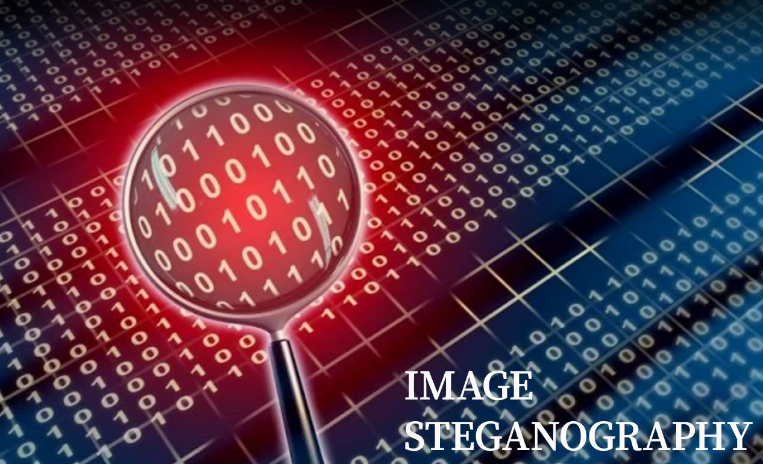
Government Polytechnic, Siddipet.
Image Steganography
Presented by
Guided by
R.L.V.K PRASAD (20189-CM-041)
K.ANUSHA (20189-CM-010)
P.NAVANITHA (20189-CM-013)
T.ESHWAR (20189-CM-017)
A.PREMSAI (20189-CM-020)
E.SREEJA (20189-CM-023)
A.SRI RAM TEJA (20189-CM-037)
P.SAHRUDAY (20189-CM-038)
G.ABHISHEK (20189-CM-049)
Mr. Nitin Pawar M.S(BITS, PILANI),
(M.TECH, OU)
Submitted for the partial fulfillment
of
Diploma in Computer Engineering
Computer Science and Engineering
Nov - 2022

Slide 2
Content
Abstract
Introduction
Methodology
LSB Substitution
Tools and technologies
Encoding Flowchart
Decoding Flowchart
Existing vs Proposed System
Cryptography vs Steganography
Advantages and Disadvantages
Applications
Conclusion
Image Steganography
Nov - 2022
2

Slide 3
1. Abstract
In this modern era, one of the major issues is to protect the secrecy of confidential data during their transmission over a public channel. So, we need a security over the data which is being transmitted. To achieve this the powerful security, Steganography is needed. Steganography is the practice of concealing the secret message with digital images, audio and video files.
In our project we are using image to hide our data. This is called as Image Steganography. Our Project aims to use the technique is LSB (Least Significant Bit) and the algorithm is spatial domain method, so, that the human eye would not notice the hidden messages within it.
Image Steganography
Nov - 2022
3

Slide 4

2. Introduction
Steganography:
Steganography is the art and science of writing hidden messages in such a way that no one, apart from the sender and intended recipient, suspects the existence of the message.
The word steganography is of Greek origin and it means “concealed writing”.
The combination of steganography and cryptography provides higher levels of security for information.
Image steganography is defined as the process of concealing data inside the images.
Fig: Steganography
Image Steganography
Nov - 2022
4

Slide 5
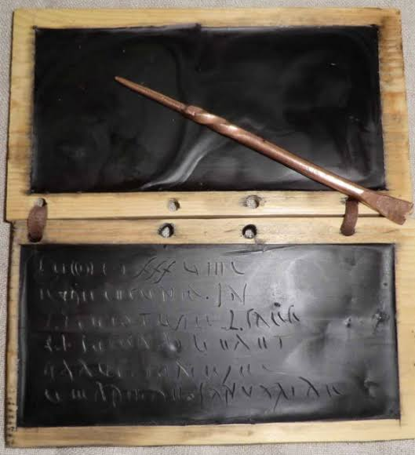
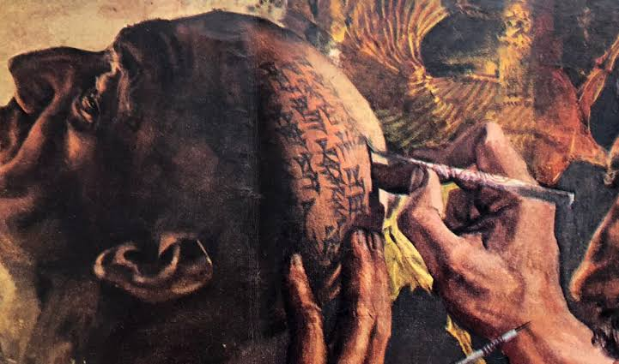
History
In ancient time, secret message was written in very fine silk or paper and then it was rolled as ball and covered with wax.
Earlier kings sent a secret message by tattooing it on the trusted slave’s scalp.
Earlier the data also was protected by hiding it on the writing tables or stomach of rabbits.
Fig: wax table
Fig: Trusted slave’s scalp
Image Steganography
Nov - 2022
5

Slide 6
PURPOSE
OBJECTIVES
SCOPE
The purpose of steganography is covert communication that is to hide the existence of a message from a third party.
To Protect confidential or sensitive data from malicious attacks.
Due to the hacking of essential information, we proposed Image Steganography.
The scope of the project is implementation of tools of steganography for hiding information in image files.
Steganographic technics are very important to our future for internet security and privacy on open systems such as an internet.
The main goal of our project is to hide a secret message within a cover media in such a way that others cannot discern the presence of the hidden message.
To provide security tools based on steganographic techniques and hide the message carried by stego -media which is not sensible to humans.
Image Steganography
Nov - 2022
6

Slide 7
3. Methodology
Types of Steganography
Steganography
TEXT
AUDIO
VIDEO
NETWORK
IMAGE
Image Steganography
Nov - 2022
7

Slide 8
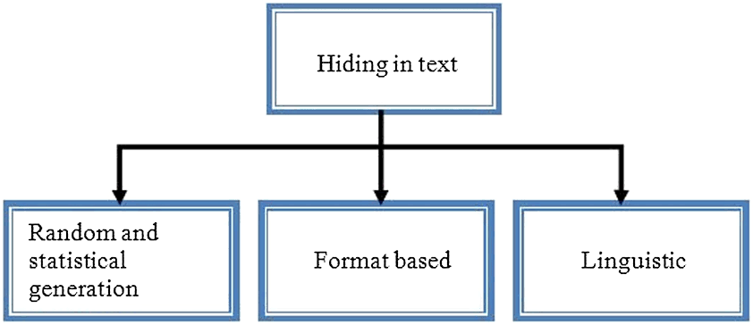
TEXT STEGANOGRAPHY:
Hiding information inside the text files.
Achieved by altering the text formatting.
Speediest form of steganography.
Cover Text
Secret message
Embedding Algorithm
Secret key
Communication Channel
Secret message
Extracting Algorithm
Fig: Methods to implement text steganography
Fig: Implementation of text steganography
Image Steganography
Nov - 2022
8

Slide 9
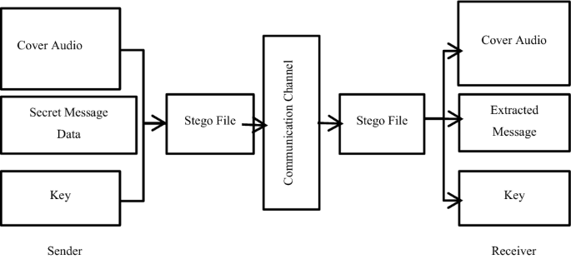
AUDIO STEGANOGRAPHY:
Approach of hiding data within audio signal.
Secret message is embedded into digitized audio signal.
Hides the data in WAV, AU and MP3 sound files.
Fig: Audio Steganography
Image Steganography
Nov - 2022
9

Slide 10
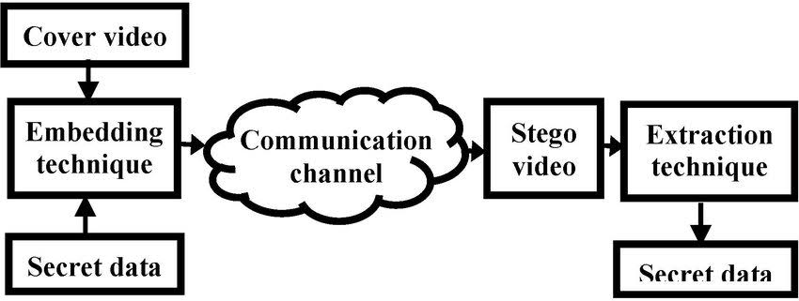
VIDEO STEGANOGRAPHY:
Data will be inserted into the video files.
In each bit frame the data will be inserted using bitmap.
Video steganography is divided into three categories:
1. Intra-embedding.
2. Pre-embedding
3. Post-embedding
Fig: Video Steganography
Image Steganography
Nov - 2022
10

Slide 11
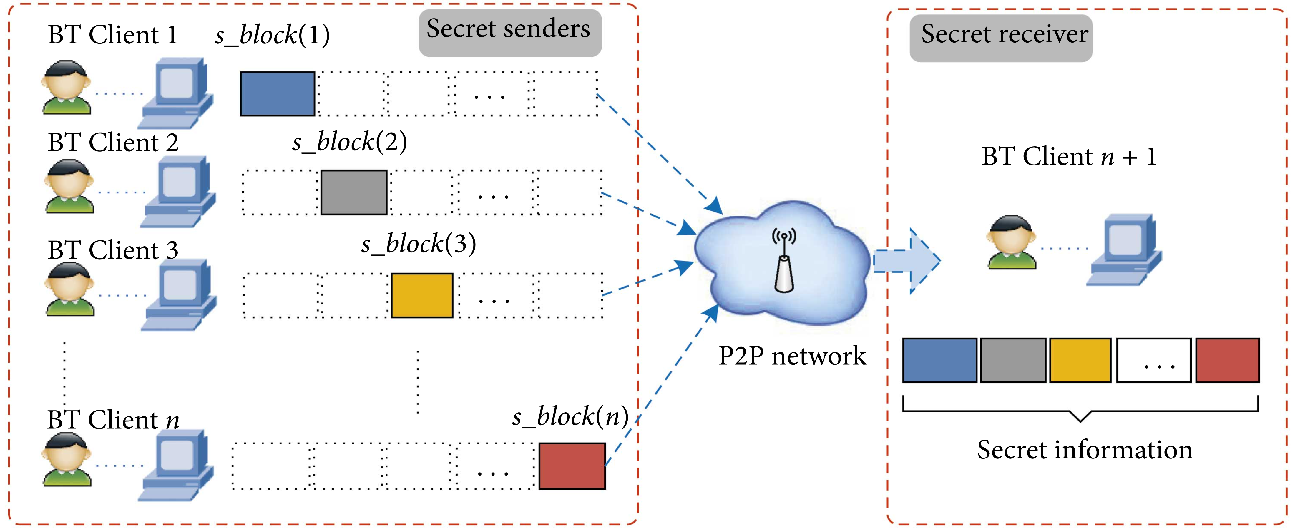
NETWORK STEGANOGRAPHY:
It is used to hide data inside network channel.
Legitimate traffic is used as vehicle to transfer data.
Ex: In a file sharing P2P service is used as the host for information hiding.
Fig: Working of network steganography
Image Steganography
Nov - 2022
11

Slide 12
IMAGE STEGANOGRAPHY:
The process of concealing data within image files.
Data is inserted into bits of image pixels.
Hiding information inside images is a popular technique.
Image will be altered in noisy areas with many colour variations.
Spatial Domain
LSB Substitution
LSB Matching
Transform Domain
Image Steganography
Pixel value difference
Distortion Technique
Discrete Fourier transformation
Discrete Cosine transformation
Masking and filtering
Discrete Wavelet transformation
Fig: Types of Algorithms
Image Steganography
Nov - 2022
12

Slide 13
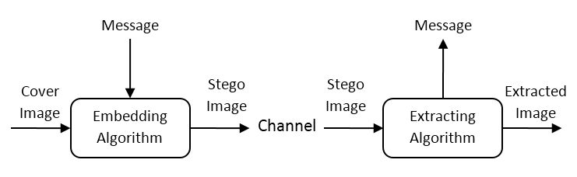
IMAGE STEGANOGRAPHY:
Fig: Working of Image Steganography
TYPES OF IMAGE COMPRESSIONS
Lossy compression.
Lossless Compression.
Image Steganography
Nov - 2022
13

Slide 14
4. LSB Substitution
Least significant bit (LSB) insertion is a common and simple method to embed data in an image file.
A least-significant-bit-based substitution method replaces some least significant bits of the host image with the secret data.
This method is very fast and easy to implement in comparison to other methods of image Steganography.
The output image has very slight difference to the input image.
Instead of embedding the message in only the LSB, we can embed the message in last four LSB’s, thus embedding even large messages.
This method forms the basics of many other complex algorithms.
It will provide high visual fidelity.
Image Steganography
Nov - 2022
14

Slide 15
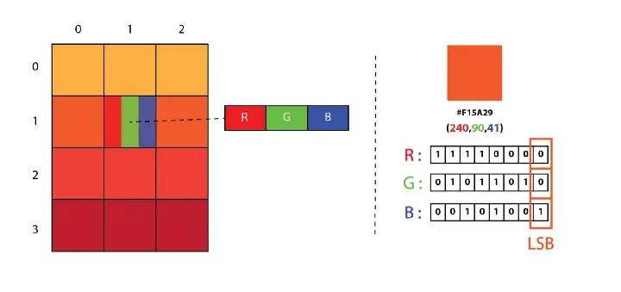
Working of LSB substitution:
The idea behind LSB embedding is that if we change the last bit value of a pixel, there won’t be much visible change in the colour.
It will begin with converting the data to be hidden into binary format.
It will convert RGB values in each pixel into 8bit binary format.
And the algorithm will insert each bit binary data to be hidden in the Least significant bit RGB binary data in each pixel.
Fig: LSB Substitution
Image Steganography
Nov - 2022
15

Slide 16
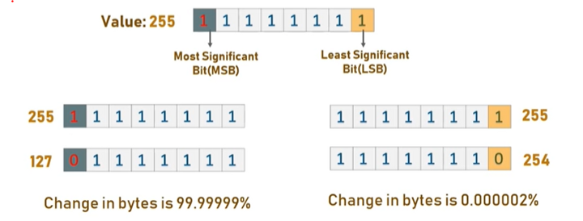
Fig: Why we should use LSB
Fig: Bit plane slicing of 3 pixels
0 | 1 | 2
5 | 3 | 7
6 | 4 | 1
000 | 001 | 010
101 | 011 | 111
110 | 100 | 001
Binary
R G B
0 | 0 | 0
1 | 0 | 1
1 | 1 | 0
0 | 0 | 1
0 | 0 | 1
1 | 1 | 0
0 | 1 | 0
1 | 1 | 1
0 | 0 | 1
MSB
LSB
Image Steganography
Nov - 2022
16

Slide 17
What’s the limit of data that can be stored?
According to LSB substitution method each pixel can store 3 bits of binary data.
We can justify that the total length of the data which can stored by an image is W*H*3/8 bytes .
Where W is the width pixel length and H is the height pixel length.
For example let us consider 12x12 pixels image would give us 54 bytes of storage in the LSB
Image Steganography
Nov - 2022
17

Slide 18
5. Tools and technologies
For implementing our project, the interactive language python is used.
We have used PyCharm IDE for implementing our program.
The packages we have used in this project:
OpenCV
NumPy
Types
Tkinter
Image Steganography
Nov - 2022
18

Slide 19
6. Encoding Flowchart
Start
Image, Message
(Caesar cipher)
Encrypt the message
Image
If Len(secret message>
Image size
Yes
Value Error
No
Convert into binary format
If data index
>=
data length
Modify the LSB of RGB of each pixel
No
Ord()
Yes
Return Image
Stop
Image Steganography
Nov - 2022
19

Slide 20
7. Decoding Flowchart
Start
Image
Convert into binary format
Extract the LSB of RGB of each pixel
Decoded binary data
Inserted data
If Decoded data[:-5]
=
Delimiter
Split the binary data into 8-bits
Convert each byte into character format
Return Decoded data[:-5]
Decrypt the data
data
No
Stop
Image Steganography
Nov - 2022
20

Slide 21
8. Existing vs Proposed System
Existence of Steganography systems
We are currently working on Image Steganography it is process of hiding secret data inside the images.
For achieving the image Steganography applications are used and some websites are also available for us.
In this applications or websites mostly, there will be options like insert ,text ,key for encryption and same process for decryption.
In the encryption process text will be concealed into image and receiver can decrypt the text by using same application or website.
Image Steganography
Nov - 2022
21

Slide 22
Proposed system
In the previously proposed systems there is a security issue as we can decrypt the text with any other application or website, this will create a problem for sender and receiver also.
To solve the above problem ,we have developed a project based on LSB substitution method works on simple GUI, our project firstly to achieve security.
In the existing systems we need internet for achieving the image Steganography. But we in proposed system you need only packages pre installed.
We are firstly encrypting the text using Caesar cipher substitution, then we encode the text into the image by using LSB substitution and the receiver should use this program for decryption.
If the third person has the image but doesn’t know the program, Suppose third person has decrypted the image using another algorithm he or she can see the text but in an encrypted way. This makes our system more robust and high security.
Image Steganography
Nov - 2022
22

Slide 23
9. Cryptography vs Steganography
Steganography | Cryptography
1. Steganography means covered writing. The process of hiding digital information in carrier signal. | 1. Cryptography means secret writing. The art and science of studying methods of protecting data.
2. Steganography does not alter the structure of the secret message. | 2. While in cryptography, the structure of data is altered.
3. It relies on the confidentiality of the method of embedding. | 3. It relies on the confidentiality of the key.
4. Spatial domain, Transform Domain, Distortion, Model- based and ad-hoc are the techniques present in Steganography. | 4. Transposition, Substitution, Stream cipher, Block ciphers are the techniques present in cryptography.
5. It is implemented on Audio, Video, Image and Text files. And it is less popular than cryptography. | 5. It is implemented only on Text Files.
6. Technology still being developed for certain formats. | 6. Most of algorithms are known by all and are developed.
7. Main challenges are Imperceptibility, embedding payload, and robustness. | 7. Main challenges are complexity of encryption and key management.
Image Steganography
Nov - 2022
23

Slide 24
10. Advantages and Disadvantages
Advantages:
Robustness.
You can store any data containing sensitive information on the server without fear of unauthorized parties gaining access to the data.
Government and law enforcement agencies can communicate secretly with the help of steganography corporations.
Hiding Capacity.
Disadvantages:
If there are large number of information, huge file size, therefore someone can suspect about it.
If this approach is gone in the wrong hands such as hackers, terrorist, criminals then this can be very much critical.
Image Steganography
Nov - 2022
24

Slide 25
11. Applications
Hide files and encryption keys.
Transport highly private documents between International Governments.
For securely transferring one time password(OTP).
Secret data storing.
Transport data without revealing the existence of available message.
Image Steganography
Nov - 2022
25

Slide 26
12. Conclusion
To achieve the data security while sending the data over a network, we have used Steganography. In that, Images are the best source for hiding data so, we have used Image Steganography. We have used a LSB algorithm in this project for developing the application. It is faster, reliable and compression ratio is the moderate compared to all algorithms. It is observed that through LSB Substitution method, the results obtained in data hiding are pretty impressive as it uses the simple fact that any image can be broken up to individual bit-planes. RGB is the color model.
We used bmp format as it contains uncompressed data while pixels are chosen at random rather than in order. We have used spatial domain algorithm and LSB substitution method. So, that a human eye would not notice the hidden message within it.
Image Steganography
Nov - 2022
26

Slide 27
Thank you

